Slide 1


INSERTION SORT By: KARDURI SUSHMA & LAKHMITHA RAVINDRANATH

Slide 2

What is Insertion sort?
Insertion sort is a type of sorting in which elements are iteratively added to an expanding array's sorted portion in their proper placements.
If the key element is smaller than its predecessor, compare it to the elements before. If the key element is larger than its predecessor, compare it to the elements before. To make space for the switched element, move the larger elements one position higher.

Slide 3

ADVANTAGES
One of the simplest sorting algorithms to comprehend and use is insertion sort.
An incoming stream of data that needs to be incrementally sorted can be effectively handled by insertion sort.

Slide 4
DRAWBACKS
slower than a number of different sorting algorithms (such as heapsort, quicksort, and merge sort)
Not suitable for real-time applications or sifting large datasets
It makes more comparisons and shifts than other effective sorting algorithms.

Slide 5
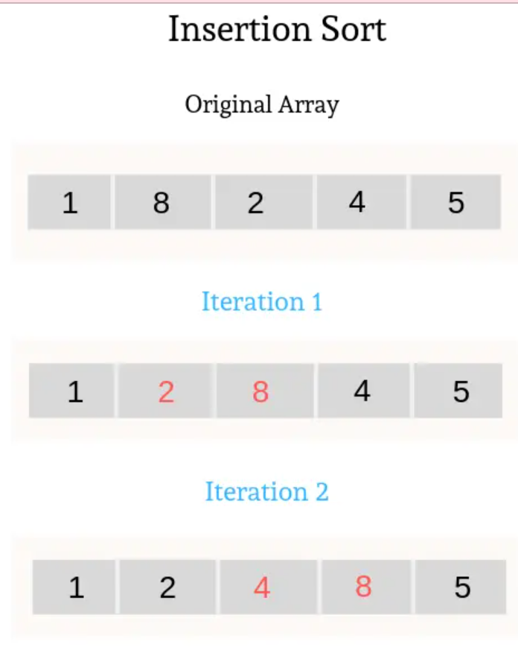



Example
Sort this array in ascending order
As 2 is the next smaller element after the 1
It is placed after 1
Swap 8 and 2
As 4 is the next smaller element after 2
It is placed after 2
Swap 8 and 4

Slide 6
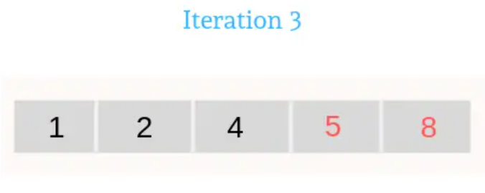
CONTINUE
As 5 is the next smaller element after 4
It is placed after 4
Swap 8 and 5

Slide 7

Time Complexity
Worst case: O(N²) comparisons
Average case: O(N²) comparisons
Best case: O(N) comparisons

Slide 8
Heap Sort By Sai Akhil Kondaveti

Slide 9
Heap-Sort Introduction
Heap Sort is a comparison-based sorting algorithm that uses a binary heap data structure.
It is an efficient algorithm for sorting large datasets.
The algorithm works by building a max heap from the input array and repeatedly extracting the maximum element to place it at the end of the sorted portion of the array.
Heap Sort has a time complexity of O(n log n) in the average and worst cases.

Slide 10
Operations
Building a Max Heap:
Start from the middle element of the array and compare it with its children to ensure it is larger.
Repeat the process for all parent nodes until the entire array forms a max heap.
Extracting Elements:
Swap the maximum element (root of the max heap) with the last element of the heap.
Reduce the size of the heap and heapify the remaining elements to restore the max heap property.
Repeat the process until all elements are extracted and sorted.

Slide 11
Implementation in Java
Implement the heapify function to maintain the max heap property:
Compare the parent node with its left and right child nodes
Find the largest element.
Swap the parent node with the largest child if necessary
Recursively heapify the affected child.
Implement the HeapSort function:
Build the max heap by calling heapify for each parent node in a bottom-up manner.
Extract elements by swapping the root with the last element, reducing the heap size, and heapifying the root.

Slide 12
Advantages
Efficient for Large Datasets
In-Place Sorting
Suitable for Worst-Case Scenarios:
Heap Sort guarantees a worst-case time complexity of O(n log n).
Can Be Used for External Sorting:
Heap Sort is suitable for sorting data that does not fit entirely in memory.

Slide 13
Disadvantages
Slower for Small Datasets:
Heap Sort is not as efficient as some simpler sorting algorithms (such as insertion sort or bubble sort) for small datasets.
Additional Space for Heap Structure:
While Heap Sort is an in-place sorting algorithm, it requires additional space to store the binary heap structure.
More Complex Implementation:
Implementing Heap Sort correctly requires a deeper understanding of the heap data structure and its operations.

Slide 14
How Heap-Sort works?
Using a heap-based priority queue, we can sort a sequence of n elements in O(n log n) time
The resulting algorithm is called heap-sort
HeapSort is of two kinds:
Min-Heap (the root node is the smallest)
Max-Heap (the root node is the largest)
(Example will be on the white board)

Slide 15
import java.util.Scanner; public class HeapSort { public static void heapSort(int[] arr) { int n = arr.length; // Build max heap for (int i = n / 2 - 1; i >= 0; i--) { heapify(arr, n, i);} // Extract elements from the heap one by one for (int i = n - 1; i > 0; i--) { // Move current root to the end int temp = arr[0]; arr[0] = arr[i]; arr[i] = temp; // Max heapify the reduced heap heapify(arr, i, 0); } } private static void heapify(int[] arr, int n, int i) { int largest = i; int left = 2 * i + 1; int right = 2 * i + 2; if (left < n && arr[left] > arr[largest]) { largest = left; }
Example Code
(Part 1)

Slide 16
if (right < n && arr[right] > arr[largest]) { largest = right; } if (largest != i) { // Swap the elements int temp = arr[i]; arr[i] = arr[largest]; arr[largest] = temp; // Recursively heapify the affected sub-tree heapify(arr, n, largest); } } public static void main(String[] args) { Scanner scanner = new Scanner(System.in); int[] arr = new int[6]; System.out.println("Enter six integers:"); for (int i = 0; i < 6; i++) { arr[i] = scanner.nextInt(); } System.out.println("Array before sorting:"); printArray(arr); heapSort(arr); System.out.println("Array after sorting:"); printArray(arr); } private static void printArray(int[] arr) { for (int value : arr) { System.out.print(value + " "); } System.out.println();
Example Code
(Part 2)

Slide 17





MinPQ By Rahul Edurinte Manuvya Sai Kotavenuka

Slide 18
Introduction
Priority Queue: Abstract data type storing elements with associated priorities
Processing Order: Based on priority, not arrival order (unlike regular queues)
Purpose: Efficient retrieval and processing of elements in priority order
Applications: Task scheduling, event handling, resource allocation
Criteria for Priority: Numeric values, timestamps, custom comparison functions

Slide 19
MinPQ Operations
Insertion: Add a new element with a priority to the MinPQ. Element is placed in the appropriate position based on its priority. Maintains the order of minimum priority at the front.
Deletion: Remove the element with the highest priority from the MinPQ. MinPQ reorganizes itself to maintain the minimum priority at the front.
Peek/Find-min: Retrieve the element with the highest priority from the MinPQ without removing it. Allows examination of the highest priority element without altering the MinPQ's structure.

Slide 20

Advantages
Efficient Minimum Retrieval: The smallest element can be retrieved continuously with MinPQ. This is especially helpful in situations where you constantly need to access the smallest piece.
Sorting: A collection of components can be effectively sorted in ascending order using MinPQ. By continually deleting the smallest piece from the priority queue, you can create a sorted sequence.
Disadvantages:
Limited Priority Access: Since MinPQ prioritizes the smallest element, iterating over the full queue may be necessary to obtain elements with higher priorities. If you regularly require access to elements with various priority, an alternative data structure might be more appropriate.
Duplicate Handling: Normally, MinPQ manages duplicate items by storing them separately. This could result in more memory being used and possibly worse performance compared to data structures built to effectively handle duplicates.

Slide 21
Implementation of MinPQ
Elementary implementations include
Unordered array
Ordered array
Binary heap
Linked Lists
Methods include swim, sink, swap, main(), delMin()
Each method uses indices in a differently

Slide 22
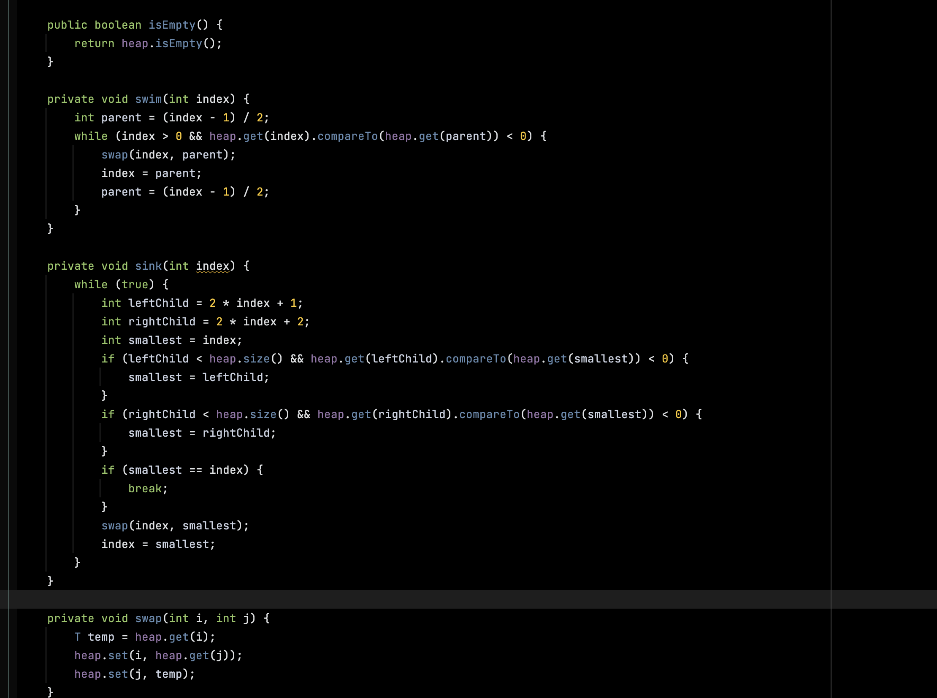
Example

Slide 23
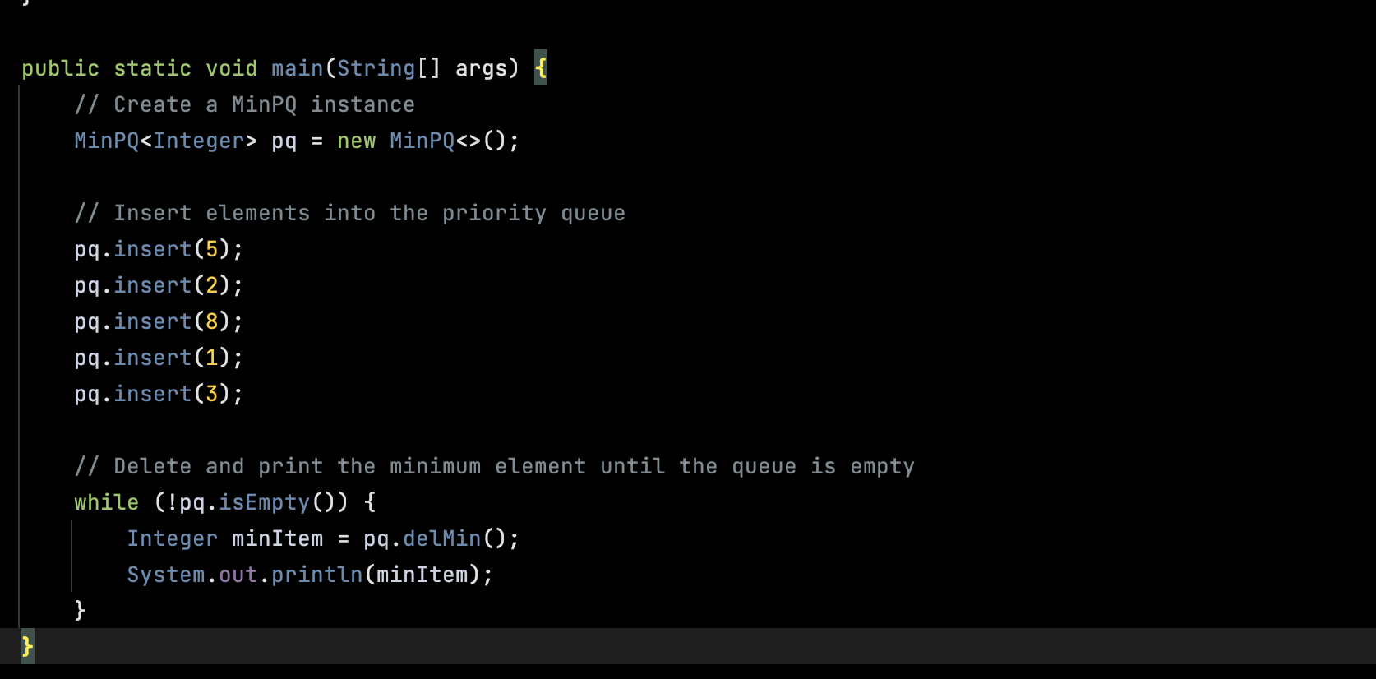
Contd..
Insertion Input

Slide 24
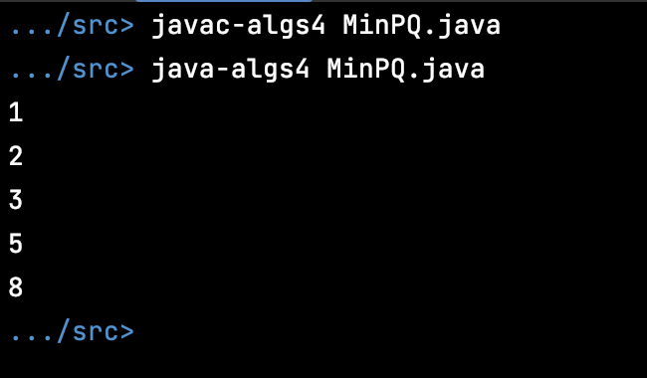
MinPQ Output

Slide 25
Thank You

Slide 26
References
https://www.cs.princeton.edu/courses/archive/fall13/cos226/lectures/99Collections+24PriorityQueues.pdf

